Slide 1
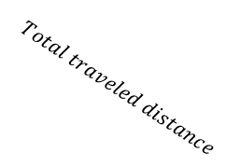
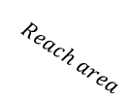
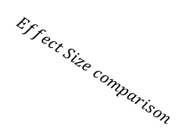
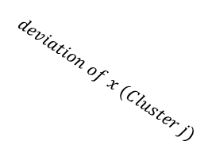


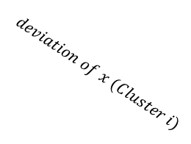
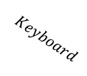


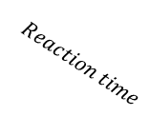
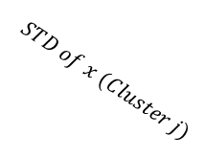
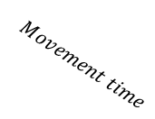
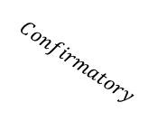
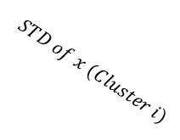


$$Effect Size comparison$$
$$Reach$$
$$Keyboard$$
$$Exploratory$$
$$Confirmatory$$
$$AUC$$
$$Reaction time$$
$$Movement time$$
$$Num of COM$$
$$Total traveled distance$$
$$MAD$$
$$Reach area$$
$$RT$$
$$deviation of x (Cluster i)$$
$$deviation of x (Cluster j)$$
$$STD of x (Cluster i)$$
$$STD of x (Cluster j)$$
Deviation
from center
Significant after
Permutation + Clustering
Cluster i
Proportion of Z traveled

